Slide 1
Mobile Application and Development
Presented By:
Mr. Nitesh Ghodichor
Assistant Processor
Department of Computer Technology, PCE, Nagpur

Slide 2
MAD
Building your first android application
Understanding anatomy of android application
Android Manifest file
UNIT-2
Android Application Design Essential
anatomy of an android application
Android terminology
Application Context, Activities, Services, Intents, Receiveing and Broadcasting Intents, Android Manifest file and its common setting ,
Using intent, filter, permission.

Slide 3
Android Architecture
What is Android Architecture?
Android is a mobile operating system that has an open-source framework and is based on Linux which helps us to develop advanced and user-friendly applications.
It comprises of five levels, which are :
the Linux kernel,
Libraries,
Application framework,
Android runtime, and
System applications.

Slide 4
5 Components of Android Architecture
Linux Kernel
Linux kernel is the bottom-most and important layer of the Android architecture and it is the core part of Android architecture.
It provides features such as:
Security
Process management
Memory management
Device management
Multitasking
It is also responsible for a level of abstraction between device hardware and upper layers of Android architecture. It consists of device drivers like camera, flash memory, Display, keypad, Wifi etc.

Slide 5
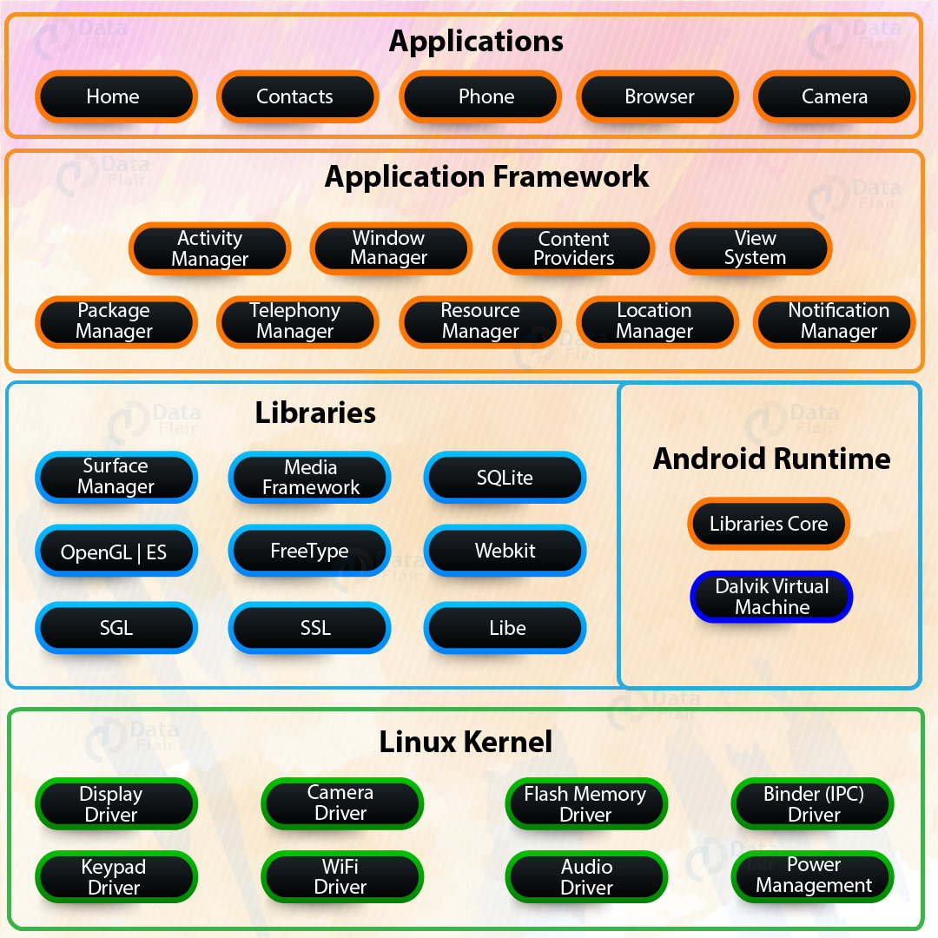
Libraries
This layer consists of a set of Libraries and Android Runtime. The Android component is built using native codes and require native libraries, which are written in C/C++ and most of the libraries are open source libraries. Also, this layer handles data that is specific to the hardware. Some of the native libraries are SSL, SQLite, Libc, OpenGL, media framework, FreeType and Surface Manager.

Slide 6
Android Runtime
It comprises of DVM (Dalvik Virtual Machine). Just like JAVA uses JVM, Android uses DVM to optimize battery life, memory and performance. The byte code generated by the Java compiler has to be converted to .dex file by DVM, as it has its own byte code. Also, multiple class files are created as one .dex file and the compressed .jar file is greater than the uncompressed .dex file.
Application Framework
The application framework built on top of the native library layer provides us with Application programming interface and higher-level services. Also, the features of the Android operating system are available to us through API’s written in form of JAVA classes. And, Android developers use these high-level services to build applications.

Slide 7
It also consists of an Android Hardware Abstraction Layer (HAL) that allows the Android Application framework to communicate with hardware-specific device drivers. It acts as an interface for hardware vendors to implement. An android application uses HAL APIs to get commands from different hardware devices.
The application framework consists of following key services:
Activity Manager: The method in this class uses testing and debugging methods.
Content provider: It provides data from application to other layers.
Resource Manager: It provides access to non-code resources.
Notification Manager: The users get notification about all the actions happening in the background.
View System: It acts as a base class for widgets and is responsible for event handling.

Slide 8
Applications
It is the top-most layer of Android architecture. This layer consists of native Android applications and third-party installed apps. They are bundled in an Android package and all the applications that are to be installed are written in this layer only such as contacts, games, settings, and messages.

Slide 9
Writing Your First Android Application
1. Choose File, New, Other....
2. Choose Android, Android Sample Project (see Figure 3.1). Click Next.
3. Choose your build target (see Figure 3.2). In this case, we’ve picked Android 4.0, API Level 14, from the Android Open Source Project. Click Next. Next,
4. Next, select which sample you want to create (see Figure 3.3). Choose Snake.
5. Click Finish. You now see the Snake project files in your workspace (see Figure 3.4).
Creating an Android Virtual Device (AVD) for Your Snake Project

Slide 10
Creating an Android Virtual Device (AVD) for Your Snake Project
The next step is to create an AVD that describes what type of device you want to emulate when running the Snake application. This AVD profile describes what type of device you want the emulator to simulate, including which Android platform to support. You do not need to create new AVDs for each application, only for each device you want to emulate.
1. Launch the Android Virtual Device Manager from within Eclipse by clicking the little Android device icon on the toolbar ( ). If you cannot find the icon, you can also launch the manager through the Window menu of Eclipse.
2. Click the New button.
3. Choose a name for your AVD. Because we are going to take all the defaults, give this AVD a name of Android_Vanilla4.0.

Slide 11
Here are the steps to create a basic AVD:
1. Launch the Android Virtual Device Manager from within Eclipse by clicking the little Android device icon on the toolbar ( ). If you cannot find the icon, you can also launch the manager through the Window menu of Eclipse.
2. Click the New button.
3. Choose a name for your AVD. Because we are going to take all the defaults, give this AVD a name of Android_Vanilla4.0.
4. Choose a build target. We want a typical Android 4.0 device, so choose Google APIs (Google Inc.) – API Level 14 from the drop-down menu. This will include the Google Android applications, such as the Maps application, as part of the platform image.
5. Choose an SD card capacity, in either kibibytes or mibibytes.

Slide 12
6. Seriously consider enabling the Snapshot feature. This feature greatly improves emulator start-up performance
7. Choose a skin. This option controls the different resolutions of the emulator.
8. Click the Create AVD button and then wait for the operation to complete.
9. Click Finish. Because the AVD manager formats the memory allocated for
SD card images, creating AVDs with SD cards could take a few moments.
Creating a Launch Configuration for Your Snake Project

Slide 13
Creating a Launch Configuration for Your Snake Project
Next, you must create a launch configuration in Eclipse to configure under what circumstances the Snake application builds and launches. The launch configuration is where you configure the emulator options to use and the entry point for your application.
You can create Run configurations and Debug configurations separately, each with different options. These configurations are created under the Run menu in Eclipse (Run, Run Configurations and Run, Debug Configurations). Follow these steps to create a basic Debug configuration for the Snake application

Slide 14
configuration for the Snake application
1. Choose Run, Debug Configurations.
2. Double-click Android Application to create a new configuration.
3. Name your Debug configuration SnakeDebugConfiguration.
4. Choose the project by clicking the Browse button and choosing the Snake project.
5. Switch to the Target tab and, from the preferred AVD list, choose the
Android_Vanilla4.0 AVD created earlier, as shown in Figure 3.6.
Running the Snake Application in the Android Emulator

Slide 15
Running the Snake Application in the Android Emulator
Now you can run the Snake application using the following steps:
1. Choose the Debug As icon drop-down menu on the toolbar ( ).
2. Pull the drop-down menu and choose the SnakeDebugConfiguration you created. If you do not see your new configuration listed, find it in the Debug Configurations listing and click the Debug button. Subsequent launches can be initiated from the little bug drop-down.
3. The Android emulator starts up; this might take a few moments to initialize. Then the application will be installed or reinstalled onto the emulator.
4. If necessary, swipe the screen from left to right to unlock the emulator, as shown in Figure 3.8.
5. The Snake application starts and you can play the game, as shown in Figure 3.9.

Slide 16
Building Your First Android Application
Now it’s time to write your first Android application from scratch. To get your feet wet, you will start with a simple “Hello World” application and build upon it to explore some of the features of the Android platform in more detail.
Creating and Configuring a New Android Project
You can create a new Android application in much the same way as when you added the Snake application to your Eclipse workspace.
The first thing you need to do is create a new project in your Eclipse workspace.
The Android Project Wizard creates all the required files for an Android application.
Follow these steps within Eclipse to create a new project:

Slide 17
Follow these steps within Eclipse to create a new project:
1. Choose File, New, Android Project, or choose the Android Project creator icon, which looks like a folder ( ), on the Eclipse toolbar.
2. Choose a project name, as shown in Figure 3.10. In this case, name the project MyFirstAndroidApp.
3. Choose a location for the project files. Because this is a new project, select the Create New Project in Workspace radio button. Check the Use Default Location check box or change the directory to wherever you want to store the source files. Click Next.
4. Select a build target for your application, as shown in Figure 3.11. choose a target that is compatible with the Android devices you have in your possession. For this example, you might use the Android 2.3.3 target or, for Ice Cream Sandwich devices, Android 4.0 (API Level 14). Click Next.
5. Configure your application information. Choose an application name. The application name is the “friendly” name of the application and the name shown with the icon on the application launcher. In this case, the application name is “My First Android App.”

Slide 18
6. Choose a package name. Here you should follow standard package namespace conventions for Java. Because all our code examples in this book fall under the com.androidbook.* namespace, we will use the package name com.androidbook.myfirstandroidapp, but you are free to choose your own package name.
7. Check the Create Activity check box. This instructs the wizard to create a default launch activity for the application. Call this Activity class MyFirstAndroidAppActivity.
8. Set the minimum SDK version. This value should be the same or lower than the target SDK API level. Because our application will be compatible with just about any Android device, you can set this number low (like to 4 to represent Android 1.6) or at the target API level to avoid annoying warnings in Eclipse. Make sure you set the minimum SDK version to encompass any test devices you have available so you can successfully install the application on them.
9. Finally, click the Finish button.
Your project settings should look like Figure 3.12.

Slide 19
Core Files and Directories of the Android Application
AndroidManifest.xml—The central configuration file for the application. It defines your application’s capabilities and permissions as well as how it runs.
project.properties—A generated build file used by Eclipse and the Android ADT plug-in. It defines your application’s build target and other build system options, as required. Do not edit this file.
proguard.cfg—A generated build file used by Eclipse, ProGuard, and the Android ADT plug-in. Edit this file to configure your code optimization and obfuscation settings for release builds.
/src folder—Required folder for all source code.
/src/com/androidbook/myfirstandroidapp/MyFirstAndroidAppActivity.java—Main entry point to this application, named MyFirstAndroidAppActivity. This activity has been defined as the default launch activity in the Android manifest file.
gencom/androidbook/myfirstandroidapp/R.java—A generated resource management source file. Do not edit this file.

Slide 20
Core Files and Directories of the Android Application
/assets folder—Required folder where uncompiled file resources can be included in the project. Application assets are pieces of application data (files, directories) that you do not want managed as application resources.
/res folder—Required folder where all application resources are managed. Application resources include animations, drawable graphics, layout files, data-like strings and numbers, and raw files.
resdrawable-*—Application icon graphic resources are included in several sizes for different device screen resolutions.
reslayout/main.xml—Layout resource file used by MyFirstAndroidAppActivity to organize controls on the main application screen.
resvalues/strings.xml—The resource file where string resources are defined. A number of other files are saved on disk as part of the Eclipse project in the workspace. However, the files and resource directories included in the list here are the important project files you will use on a regular basis.

Slide 21
Running Your Android Application in the Emulator
MyFirstAndroidApp application using the following steps:
1. Choose the Run As icon drop-down menu on the toolbar ( ).
2. Pull the drop-down menu and choose the Run configuration you created. (If you do not see it listed, choose the Run Configurations... item and select the appropriate configuration. The Run configuration shows up on this dropdown list the next time you run the configuration.)
3. Because you chose the Manual Target Selection mode, you are now prompted for your emulator instance. Change the selection to Launch a New Android Virtual Device and then select the AVD you created, as shown in Figure 3.13. Here you can choose from an already-running emulator or launch a new instance with an AVD that is compatible with the application settings

Slide 22
Running Your Android Application in the Emulator
4. The Android emulator starts up, which might take a moment.
5. Click the Menu button or push the slider to the right to unlock the emulator.
6. The application starts, as shown in Figure 3.14.
7. Click the Back button in the Emulator to end the game or click Home to suspend it.
8. Click the grid button to browse all installed applications. Your screen looks something like Figure 3.15.
9. Click the My First Android Application icon to launch the application again.

